Slide 1




“MAGANDANG UMAGA SA LAHAT”

Slide 2


Slide 3

Notes:
It is the equal treatment to all the people, regardless of the gender preference we have.

Slide 4


The Sustainable Development Goals (SDGs) aim to build on these achievements to ensure that there is an end to discrimination against women and girls everywhere and also to promote equality.
Notes:
Thru SDG we can promote equality. Because it is very important for all of us nowadays to have a good relationship with one another.

Slide 5


“EQUALITY IS PRESENT IN OUR COUNTRY”

Slide 6

LAWS
UNIVERSAL DECLARATION OF HUMAN RIGHTS
(CEDAW)- CONVENTION ON THE ELIMINATION OF ALL FORMS OF DISCRIMINATION AGAINST WOMEN
REPUBLIC ACT 9710 “MAGNA CARTA OF WOMEN”
Notes:
Men and women, the LGBTQIA+, Young and Old, the Rich And the Poor

Slide 7



Slide 8

The 'SOGIE Equality Bill', also known as
Sexual Orientation and Gender Identity and Expression Equality Bill, aims to prevent any discrimination against people based on their gender identity, sexual orientation and expression.
https://brainly.ph/question/2374742#readmore

Slide 9


SOGIE Bill is for…
“L-G-B-T-Q People” Lesbian Gay Bisexual Transgender Queer

Slide 10
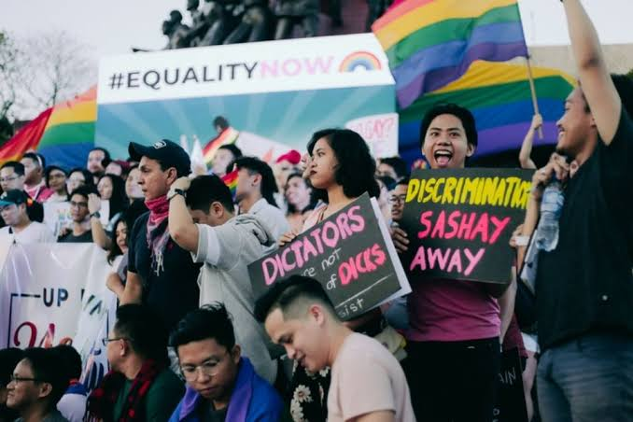
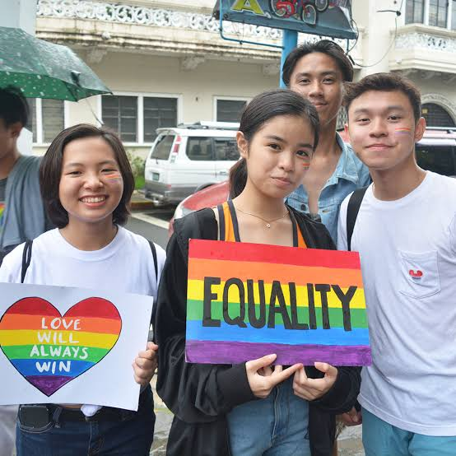
“ADVOCATES OF GENDER EQUALITY IN PHILIPPINES”

Slide 11
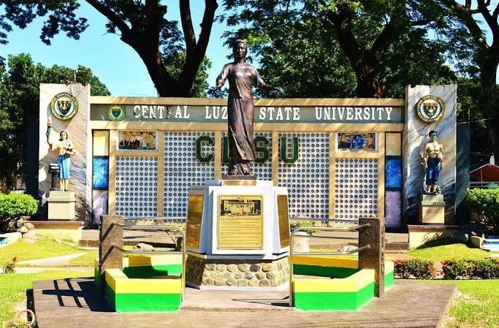

“THERE IS ALSO EQUALITY IN OUR UNIVERSITY”

Slide 12

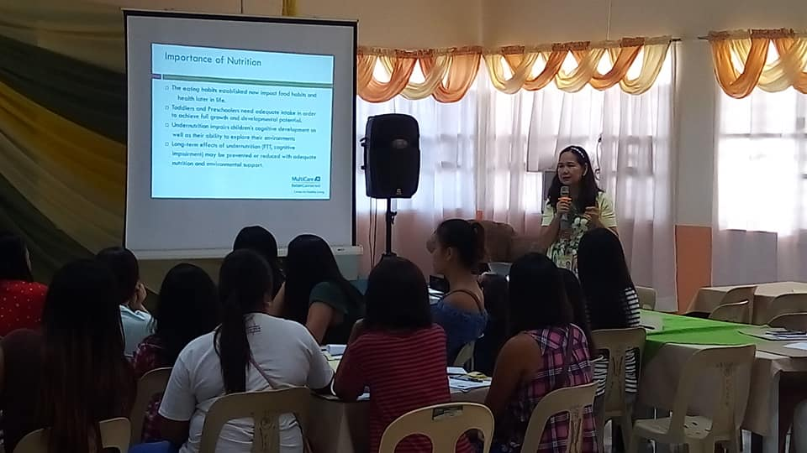
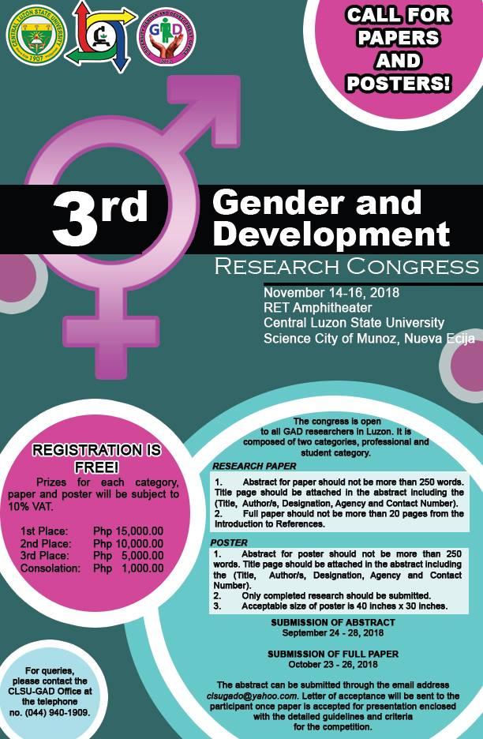

Slide 13

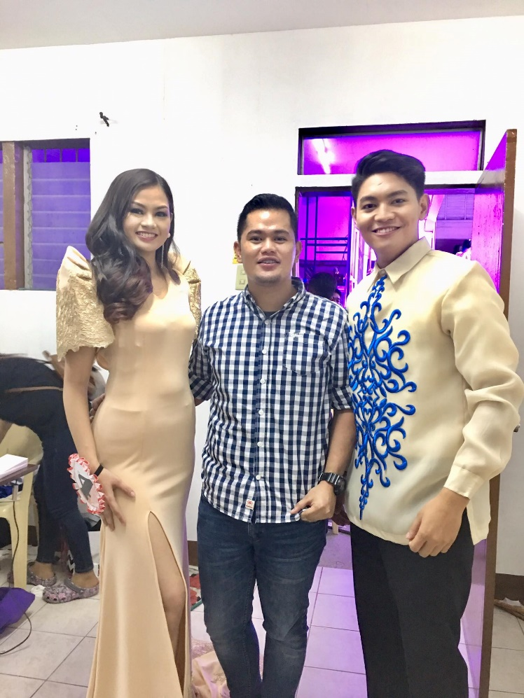
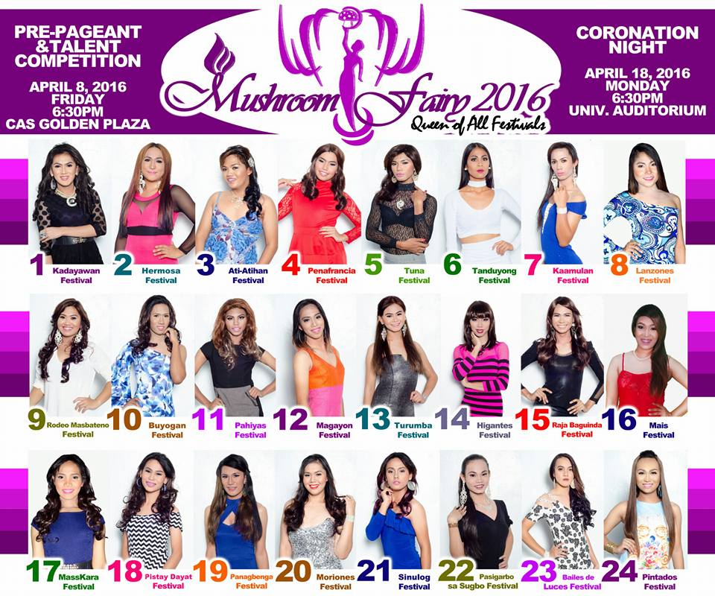
CLSU-Office of Student Affairs

Slide 14

Central Luzon State University Promotes Equality
Vision
The University Gender and Development Program (UGADP) envisioned an attainment of gender equality and full participation of men and women within the University to provide a socially responsible environment that is free from gender inequality.
Mission
To unify all efforts in all the units of the university in promoting gender responsive manner among men and women through participatory approaches for gender justice and equality. Objectives
To actively advocate gender and development issues and concepts thru gender sensitive trainings, seminars, and Information Education Communication (IEC) materials
To implement gender mainstreaming geared towards promoting gender equity in all units of the university as provided by law
To conduct researches integrated with gender issues and concepts
To integrate the principles of gender equality in curricular offerings and pedagogical systems and strategies

Slide 15
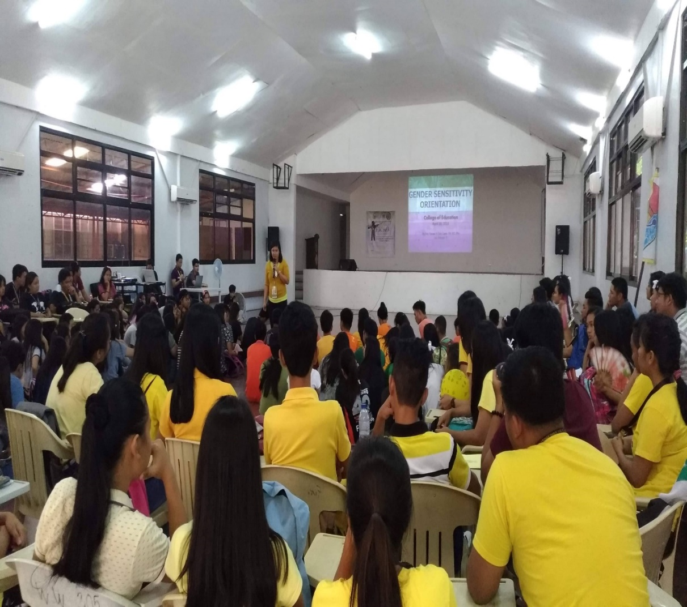
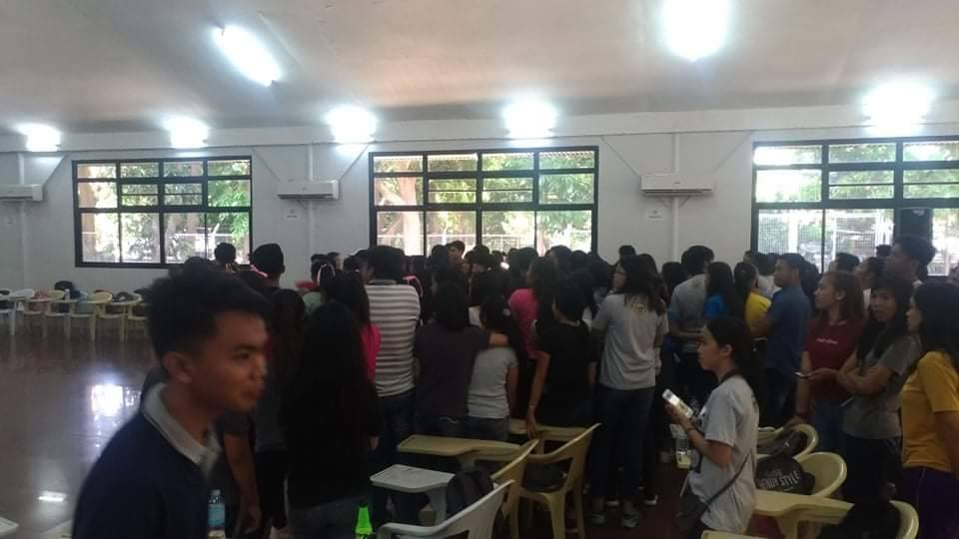
CLSU-College of Education

Slide 16
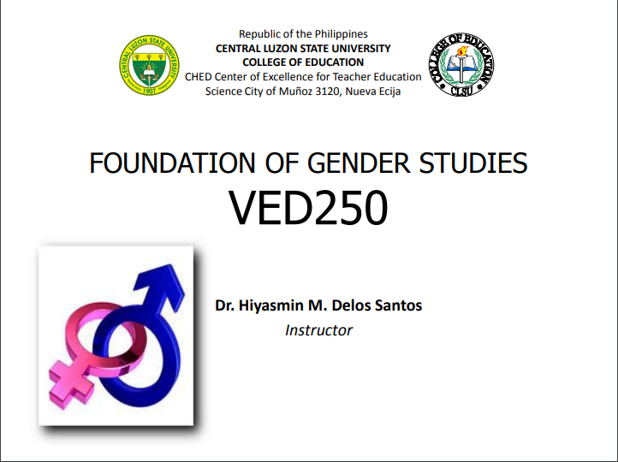

CLSU- College of Education

Slide 17

THANK YOU FOR YOUR KIND ATTENTION AND PARTICIPATION ! “MARAMING SALAMAT !”

Slide 18


Slide 19

QUALITY EDUCATION

Slide 20




QUALITY EDUCATION IN PHILIPPINES

Slide 21

DID YOU KNOW THAT…

Slide 22


QUALITY EDUCATION IN OUR SCHOOL

Slide 23

THE VISION, MISSION, & PHILOSOPHY OF OUR UNIVERSITY

Slide 24


ACHIEVERS & ACHIEVEMENT
TOP 2- BEST AGRICULTURAL SCHOOL IN THE PHILIPPINES
TOP 2- BEST VETERINARY SCHOOL IN THE PHILIPPINES
Out of 8 Colleges, 4 are Center of Excellence

Slide 25
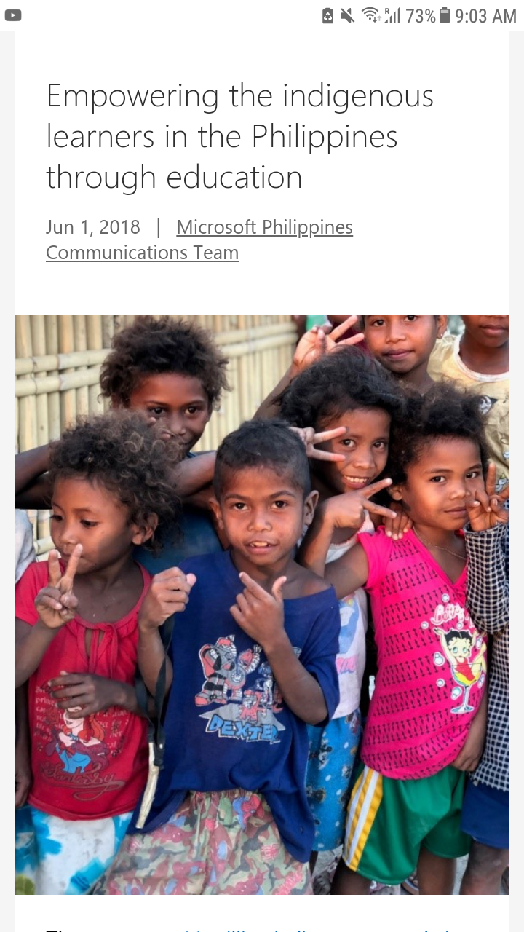
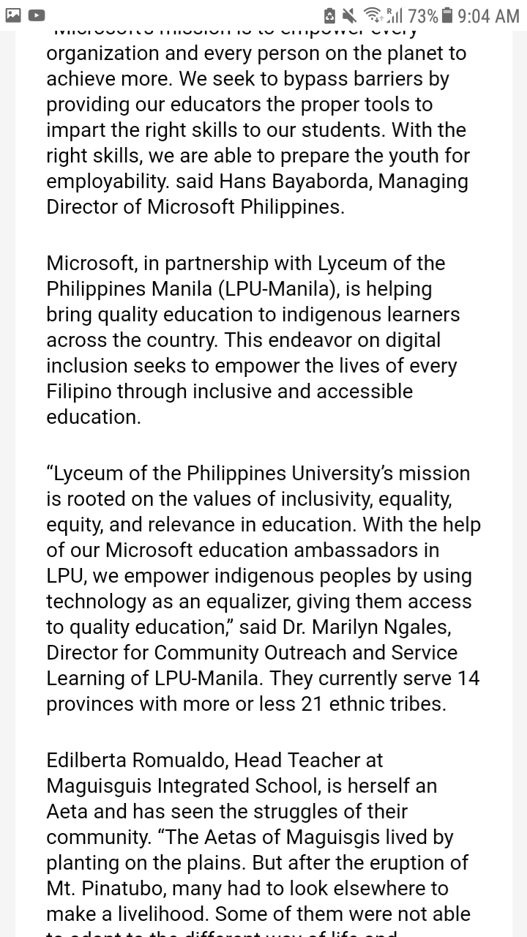

SCHOLARSHIPS AND PRIVILEGES OF STUDENTS (including the Indigenous People)

Slide 26


CLSU RANKING IN PHILIPPINES

Slide 27
THANK YOU FOR YOUR KIND ATTENTION AND PARTICIPATION ! “MARAMING SALAMAT !”

